Slide 1
Jesuit Refugee Service UK

Slide 2
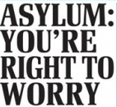
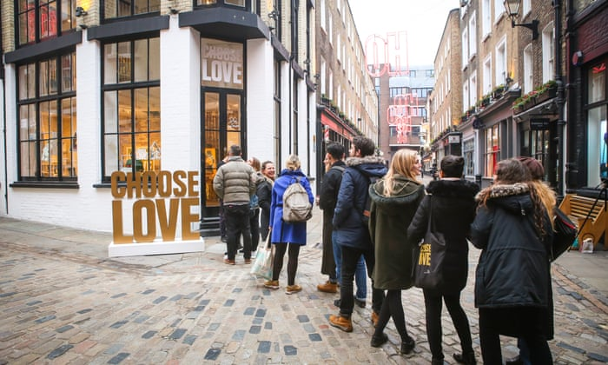
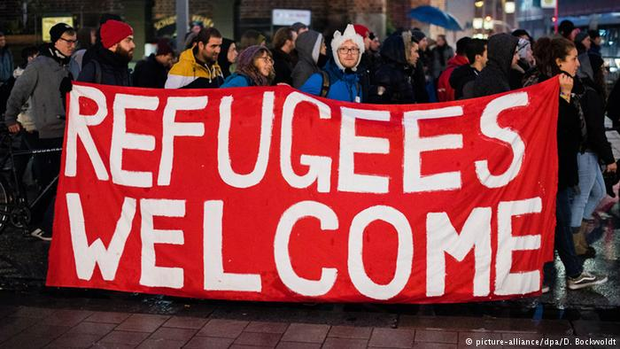
How do we see refugees and asylum seekers?

Slide 3
Definitions
Refugee - is someone who “owing to wellfounded fear of being persecuted for reasons of race, religion, nationality, membership of a particular social group or political opinion, is outside the country of his nationality and is unable or, owing to such fear, is unwilling to avail himself of the protection of that country; or who, not having a nationality and being outside the country of his former habitual residence as a result of such events, is unable or, owing to such fear, is unwilling to return to it”

Slide 4
Definitions
Asylum Seeker – A person who has fled their own country and seeks sanctuary in another country, applies for asylum – the right to be recognized as a refugee and receive legal protection and material assistance. An asylum seeker must demonstrate that his or her fear of persecution in his or her home country is well-founded.

Slide 5
Quick Fire Questions
How many refugees were there at the end of 2019?
26 million
2.6 million
260,000
Source: UNHCR Global Trends Report 2019. Available at: https://www.unhcr.org/5ee200e37.pdf

Slide 6
Quick Fire Questions
Which country hosts the most refugees?
Turkey
Germany
Uganda
Source: UNHCR Global Trends Report 2019. Available at: https://www.unhcr.org/5ee200e37.pdf

Slide 7
Quick Fire Questions
How many asylum seekers came to the UK in 2019?
1.35 million
135,000
35,500
Source: Home Office Statistics. Available at: https://www.gov.uk/government/statistical-data-sets/immigration-statistics-data-tables-year-ending-march-2020#asylum-and-resettlement

Slide 8
Our friends’ experiences
“Like we don’t want to be dependent on the government all the time. At least we should work and do some certain jobs we can do and there is little work that we can do so that we don’t just rely on the government for everything. There are some things that we can do, to earn some money for ourselves. The government should give the asylum seekers who have been here for many years, sometimes like 10 years, to give them their documents so they can work.”

Slide 9
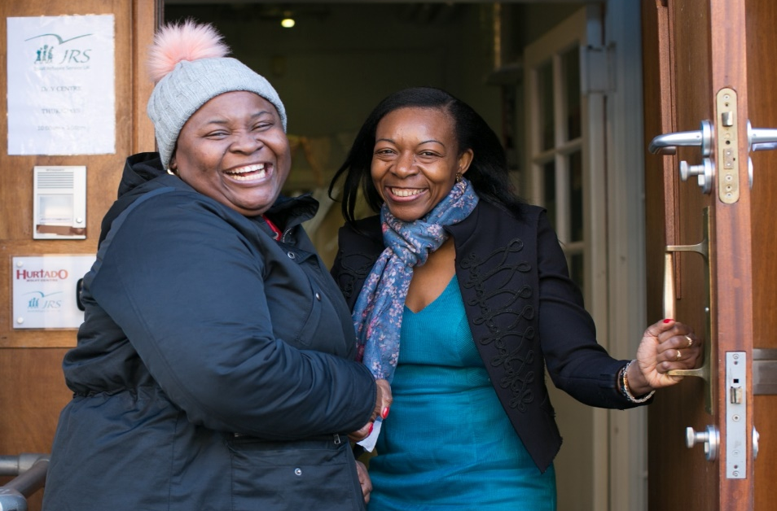
Day Centre

Slide 10
Our friends’ experiences
“The toughest thing about being destitute? Not having a place to shower or to clean your teeth or to take good care of yourself. It’s humiliating when you see someone, even a friend, turn away from you because you’ve not been able to wash yourself or your clothes for the last couple of days. It’s not easy”.

Slide 11
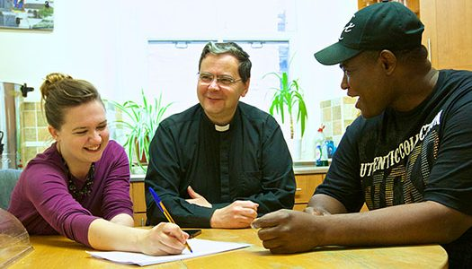
At Home
"They showed me acceptance and love... unconditional love. I felt like a part of the family, I truly felt at home."

Slide 12
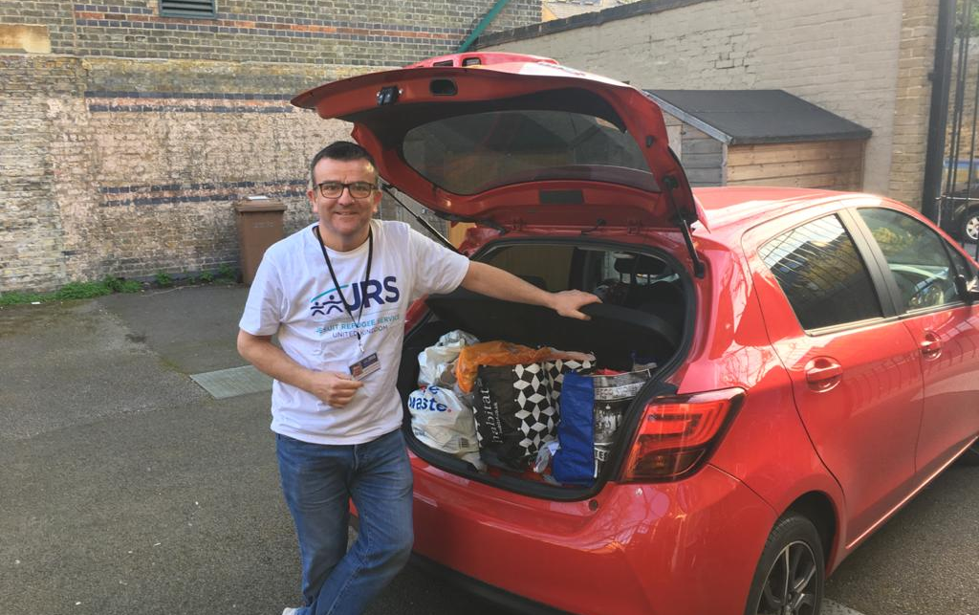
COVID-19 Response

Slide 13
How would you feel?

Slide 14
What can you do?
Spend some time thinking about what it would be like to flee your home and have to go a seek safety in a completely foreign country.
You may have family members, parents or grandparents who came to live in this country. Ask them about how it felt to come to a new place – refugee or not, they will help you understand a little!
Find out more about the work of JRS UK and see how they help those refugees who are in need in the UK.
Pray for refugees and all those seeking safety.

Slide 15
JRS Prayer
Lord Jesus,
Give us courage to accompany others, for in walking at their side we find you there present with us.
Give us joy that we might serve others, for in tending the wounds of those who suffer, we sense your healing grace at work in us.
Give us wisdom as we advocate for others, for in defending the downtrodden we hear your voice speak for us.
Grant that in all we do, we may give you glory Lord; we return all we have in love to you, for you have given everything to us.
Amen.

Slide 16
Get in touch
Website: www.jrsuk.net
Email: uk@jrs.net | Tel: 020 7488 7310
Twitter: @JRSUK | Facebook: jesuitrefugeeserviceuk

